Slide 1

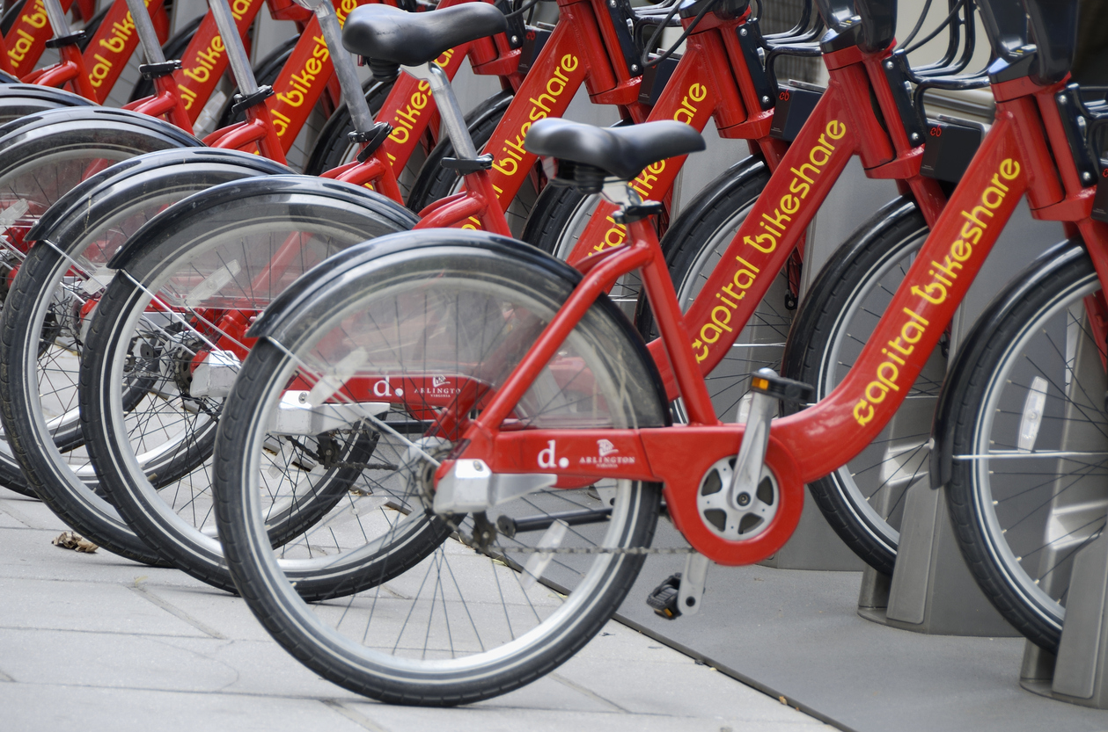
Time Series Forecasting:
Capital Bikeshare Rentals
Tyson Biegler | ID: 012170282
Master of Science, Data Analytics

Slide 2




Bachelor of Science
in Psychology
CS50b
Computer Science for
Business Professionals
Google Data Analytics Professional Certificate
Master of Science in Data Analytics

Slide 3
Bachelor of Science
in Psychology
CS50b
Computer Science for
Business Professionals
Google Data Analytics Professional Certificate
Master of Science in Data Analytics

Slide 4
Bachelor of Science
in Psychology
CS50b
Computer Science for
Business Professionals
Google Data Analytics Professional Certificate
Master of Science in Data Analytics
2022
2025
2013
2022

Slide 5
Bachelor of Science
in Psychology
CS50b
Computer Science for
Business Professionals
Google Data Analytics Professional Certificate
Master of Science in Data Analytics

Slide 6
Bachelor of Science
in Psychology
CS50b
Computer Science for
Business Professionals
Worked in the mental health field for 10 years.
Didn’t like the schedule.
Very limited options for advancement in a career.
Oftentimes, very dangerous environments.
Google Data Analytics Professional Certificate
Worked in the mental health field for 10 years.
Didn’t like the schedule.
Very limited options for advancement in a career.
Oftentimes, very dangerous environments.
Master of Science in Data Analytics
Worked in the mental health field for 10 years.
Didn’t like the schedule.
Very limited options for advancement in a career.
Oftentimes, very dangerous environments.

Slide 7








Hypothesis
Process
Findings
Limitations
Actions
Benefits

Slide 8
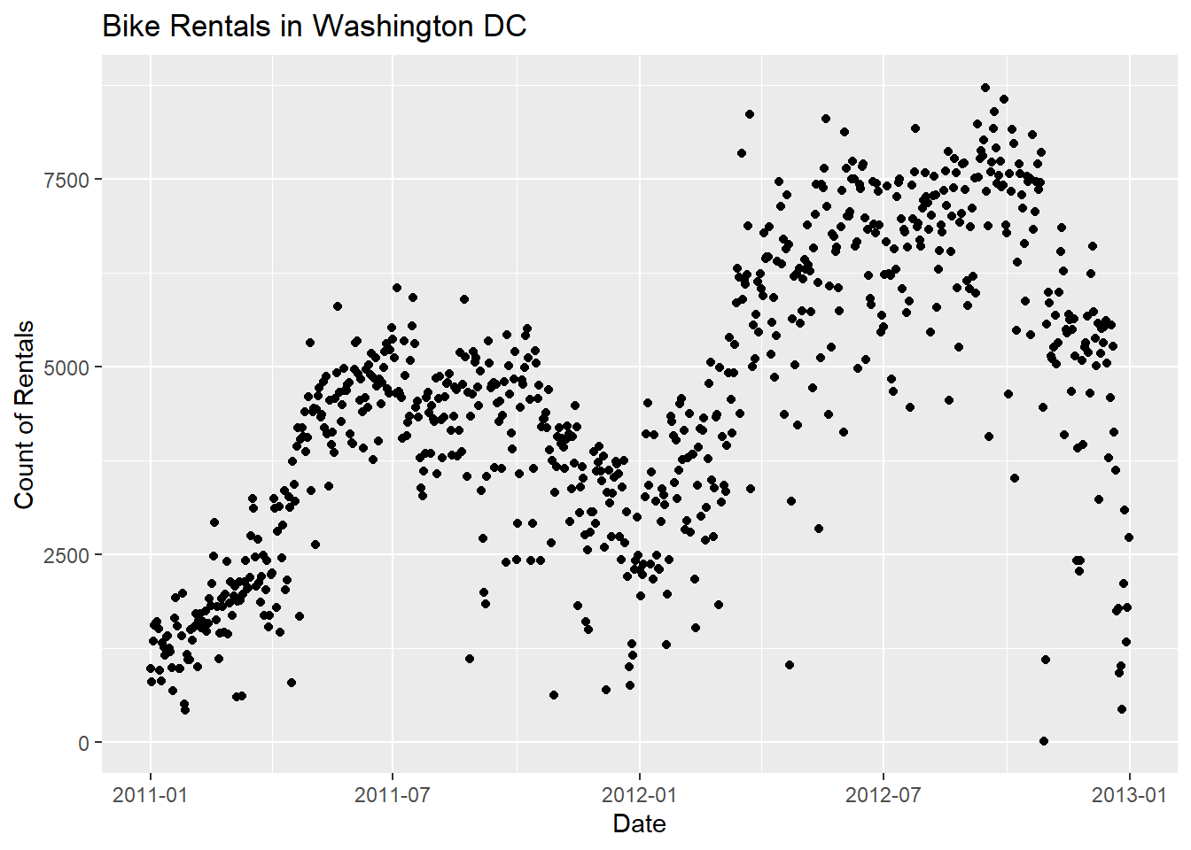
Hypothesis
My goal is to assess whether incorporating external variables like temperature, humidity, and US holidays improves the forecasting accuracy of daily bike rentals for Capital Bikeshare in Washington, DC.
Null hypothesis - These variables do not statistically significantly enhance the forecasting accuracy
Alternative hypothesis - These variables do statistically significantly enhance the forecasting accuracy.
Accurately forecasting bike rental demand is critical, given that Washington experiences a high influx of tourism each year.
Here we can see a clear upward trend and seasonal patterns. For example, it appears that the winter months have consistently fewer rentals than the summer months.

Slide 9

Process
The data used in this analysis was gathered from the UCI Machine Learning Repository, which contains two years of daily bike rentals.
I created two different time series models using the Metra Prophet framework.
The first is the baseline model, which includes the Date and the Rental Count.
The second is the Enhanced model, which includes the baseline variables in addition to Temperature, Humidity, and US Holidays.
I tested the models by training them on about a year and a half of the past data, checking how they performed over the next month and then predicted three months into the future.
I measured how far off their predictions were from the actual results using the Root mean square error (RMSE). Then I ran a test to compare the RMSE of each model and see if the difference was due to chance or if it was actually meaningful.
The model with the lower error score is more accurate.

Slide 10
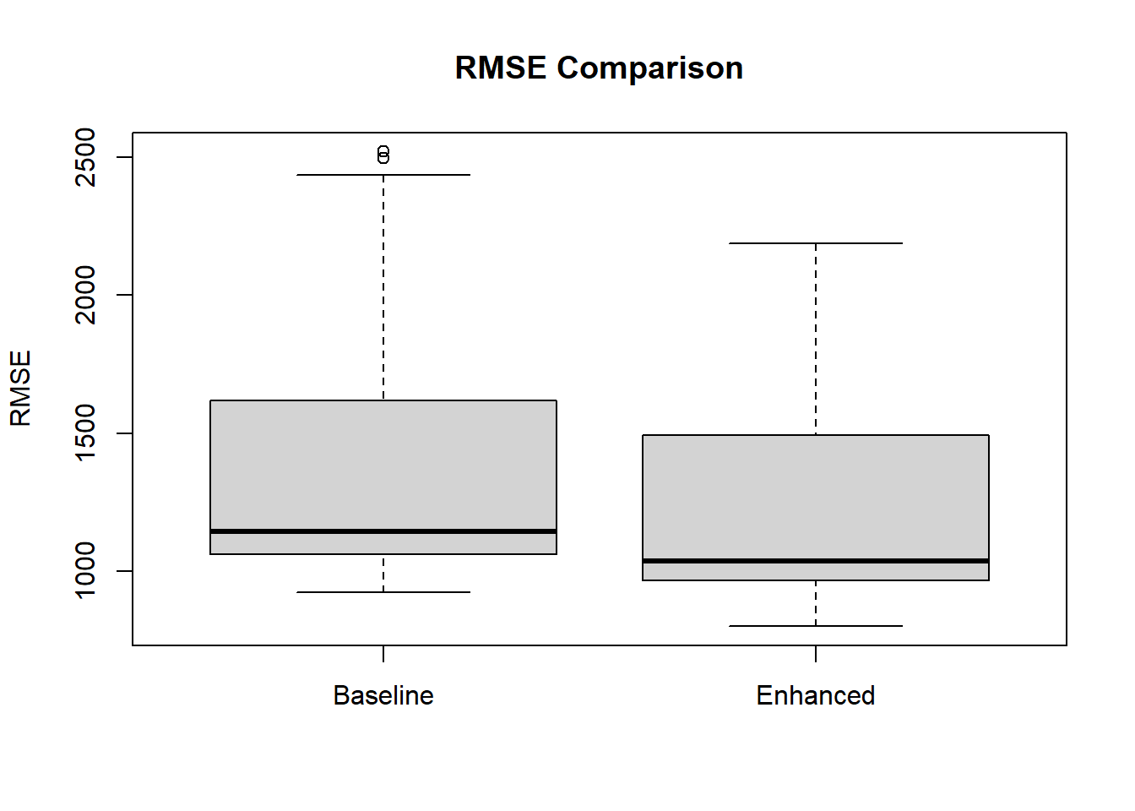
Findings
After comparing the RMSE values of the two models by using a t-test, I found that the enhanced model had a statistically significantly lower RMSE, making it the preferred model.
These findings would support the alternative hypothesis that these external factors ‘temperature,’ ‘humidity,’ and ‘US holidays’ do in fact significantly improve the forecasting accuracy.

Slide 11
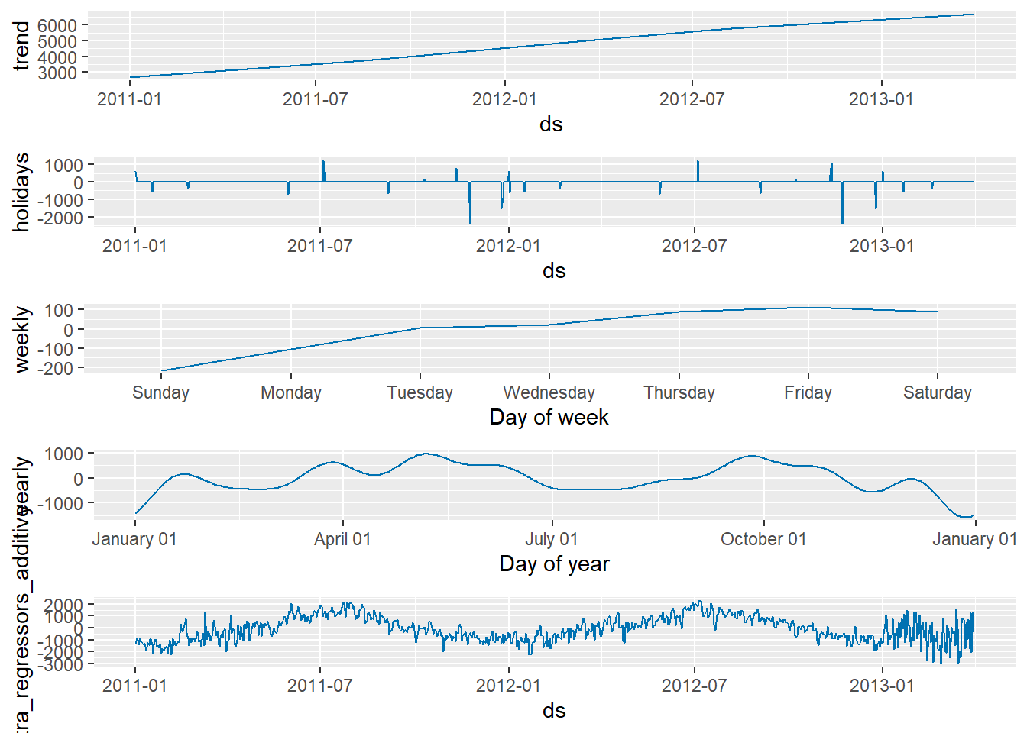
Findings
The component plot shows that there is an upward trend in rentals.
The large spikes show that the US holidays do effect rentals.
During the week rentals start off slow on Sunday and will hit a peak by Friday.
Yearly we can see that January consistently has the lowest amount of rentals while April, May, and October share the highest rentals.

Slide 12
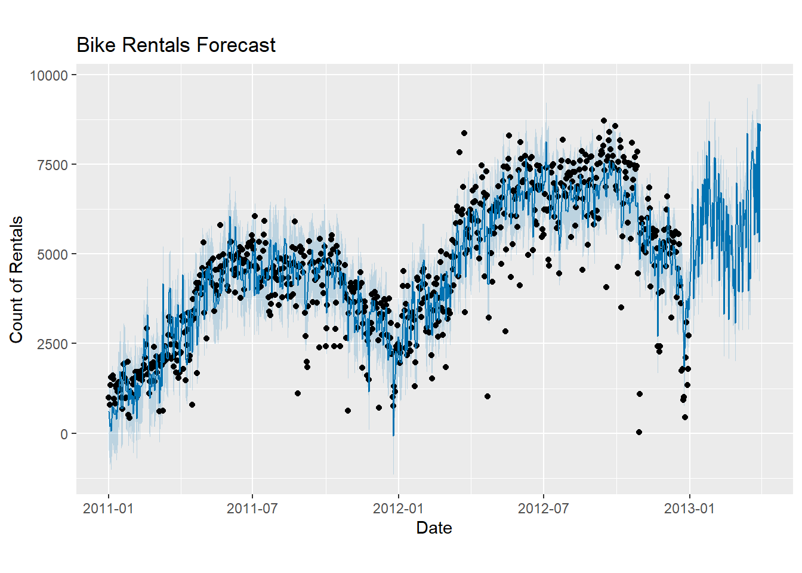
Findings
The 90-day forecast appears to have captured the trends and seasonal patterns of the historical data.

Slide 13
Hypothesis
Process
Findings
Limitations
Actions
Benefits

Slide 14
Limitations
When using the Prophet forecasting framework, it is required to supply the forecasted regressor values. This means that I will need to supply the temperature, humidity, and US holidays for 90 days in the future. Because it is not possible to predict the weather that far in advance, I needed to simulate the temperature and humidity based on the historical values from the prior year. Because these values needed to be simulated, the model’s reliability may suffer.

Slide 15

Actions
Capital Bikeshare should integrate weather forecasts and holiday calendars into its inventory management strategies to optimize bike allocation. Real-time weather data and holiday schedules can inform daily and seasonal planning, ensuring sufficient bike availability during peak demand periods and holidays.

Slide 16

Benefits
Implementing this enhanced model’s forecast data into Capital Bikeshare’s inventory allocation strategies would ensure that bikes are distributed more efficiently and that demand is being met throughout the year, particularly on holidays and times when weather is predicted to be extreme.

